Slide 1
Sentence Embeddings
Mica Haney
Tapeswar Paul
Bharath Kumar Suroju

Slide 2
What is an Embedding?
In the context of NLP, when we’re talking about embeddings, what we are really talking about is vectors. And what's a vector. A vector is just a set of real numbers.
An embedding refers to something that's been translated into a vector. This numerical representation as an array of numbers is useful because it facilitates a wide variety of mathematical operations.

Slide 3
What is a Word Embedding?
“You shall know a word by the company it keeps”
- British linguist JR Firth
Vector representations of words could be used to discover semantic meaning without requiring domain specific knowledge.
Essentially, you don’t need to know all the rules of grammar or even the dictionary definition of a word to understand it. Instead, you just need to see what other words it is used with. Then you can know whether it is similar to other words, since they may share the same “company,”.

Slide 4
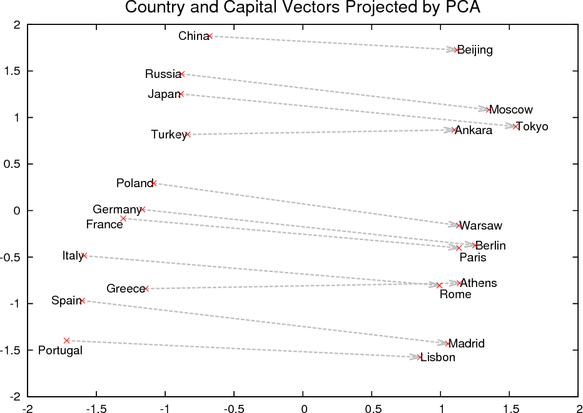
What is a Word Embedding?

Slide 5
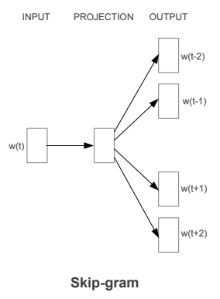
Skip-Grams
For skip-gram the input is a middle word in a sequence. The network then tries to predict the surrounding words.

Slide 6
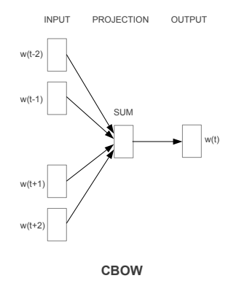
CBOWs
In CBOWs the input is the surrounding words and the network tries to predict the middle word. If the prediction is incorrect this is fed back to the network and the weights and bias are tweaked and the process continues until it can accurately predict the target word(s).

Slide 7
What is a Sentence Embedding?
Since sentences are essentially made up of words, it may be reasonable to argue that simply taking the sum or the average of the constituent word vectors should give a decent sentence representation. This is akin to a bag-of-words representation, and hence suffers from the same limitations
It ignores the order of words in the sentence.
It ignores the sentence semantics completely.

Slide 8
Topic Modeling
Topic modeling uses a bag-of-words probability distribution of the text in a document to assign topics to a document.
How is this done?
Take all of the words in a document. Strip out unwanted words, and lemmatize words.
Count occurrences of words to get the distributions.
Assign different distributions of words different topics.

Slide 9
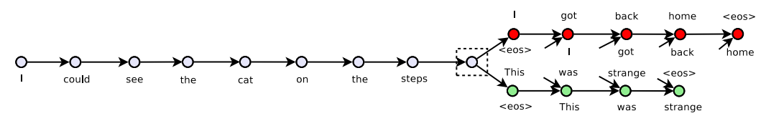
Skip-Thought Vectors
Skip-thought vectors use surrounding sentences to predict a sentence. They make high use of semantics, syntax, and context.
The model is trained by feeding word embeddings to a RNN. The model takes the sentences on either side of the target sentence, and independently use them to map a new embedding to the sentence.

Slide 10
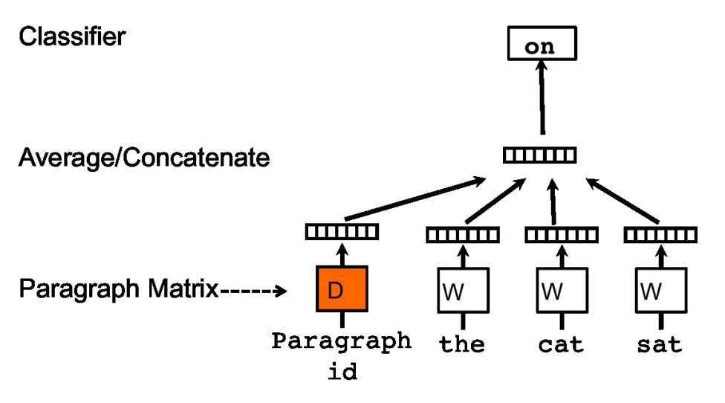
doc2vec
doc2vec expands the word2vec model. It creates a vector for the paragraph (document) to act as context for predicting the next word.
Each paragraph is assigned a unique vector. Each word is assigned a unique vector. The paragraph and word vectors are concatenated or averaged for prediction purposes.
The paragraph vector can be thought of as context or memory.

Slide 11
Weighted Sum of Word Vectors
A sentence embedding is represented by a sum of all of its word embeddings, each embedding weighted based on how often it occurs in the document.
Common words are weighted down by the below factor, decreasing their effect. Documents are defined more by their more uncommon words.
a / (a + p(w)) Where a is a hyperparameter, and p(w) is the estimated word frequency.

Slide 12
Embeddings Applications
WORD EMBEDDING APPLICATIONS:
Word Vectors for Bioinformatics
Music\Video recommendation systems
Named entity recognition(NER)
SENTENCE EMBEDDING APPLICATIONS:
Automate Customer Support
Language Prediction
Classification of documents

Slide 13
References
https://mlexplained.com/2017/12/28/an-overview-of-sentence-embedding-methods/
ttps://towardsdatascience.com/nlp-extracting-the-main-topics-from-your-dataset-using-lda-in-minutes-21486f5aa925
https://dzone.com/articles/applications-of-word-embeddings-in-nlp
https://arxiv.org/pdf/1405.4053.pdf
https://towardsdatascience.com/transforming-text-to-sentence-embeddings-layer-via-some-thoughts-b77bed60822c
https://www.intel.ai/building-skip-thought-vectors-document-understanding/#gs.bmx8zb
https://blog.floydhub.com/automate-customer-support-part-one/
https://mlexplained.com/2017/12/28/an-overview-of-sentence-embedding-methods/

Slide 14
Questions?

Slide 15
Notes
Mica: Word Embeddings
Tapeswar : Sentence Embeddings
Bharath: Applications
Some word embedding algorithms (BERT, XlNet) use sentence embeddings to generate word emeddings. Specify algorithms discussed.
Readings: Word Embeddings: https://arxiv.org/pdf/1301.3781. https://blog.floydhub.com/automate-customer-support-part-one/
Sentence Embeddings: https://mlexplained.com/2017/12/28/an-overview-of-sentence-embedding-methods/ https://en.wikipedia.org/wiki/Sentence_embedding (Note: use references)
https://medium.com/explorations-in-language-and-learning/how-to-obtain-sentence-vectors-2a6d88bd3c8b

